Slide 1
BTP Presentation
Rendezvous of Dubins cars in short range
By
Tanya Choudhary
Guided by Prof Debraj Chakraborty

Slide 2
The Task
Finding time optimal trajectories for rendezvous of Dubins vehicles
Problem has been studied before in the case of large distance separation
We look at the case of short distances particularly

Slide 3
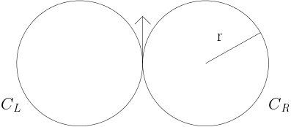
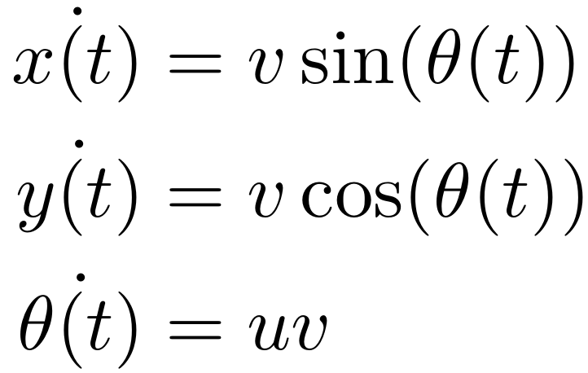
Dubins Car
Moves only in forward direction
Maximum speed of v_{s}.
Minimum turning radius is r (= 1/umax).
Dynamics:

Slide 4
Reachability Set
Used to visualize shortest paths to any destination
Set of points a vehicle can reach in time ≤ T.
Shortest path has been proved to be CL or CC¹
G. J. Cockayne, E & W. C. Hall, “Plane motion of a particle subject to curvature constraints”

Slide 5
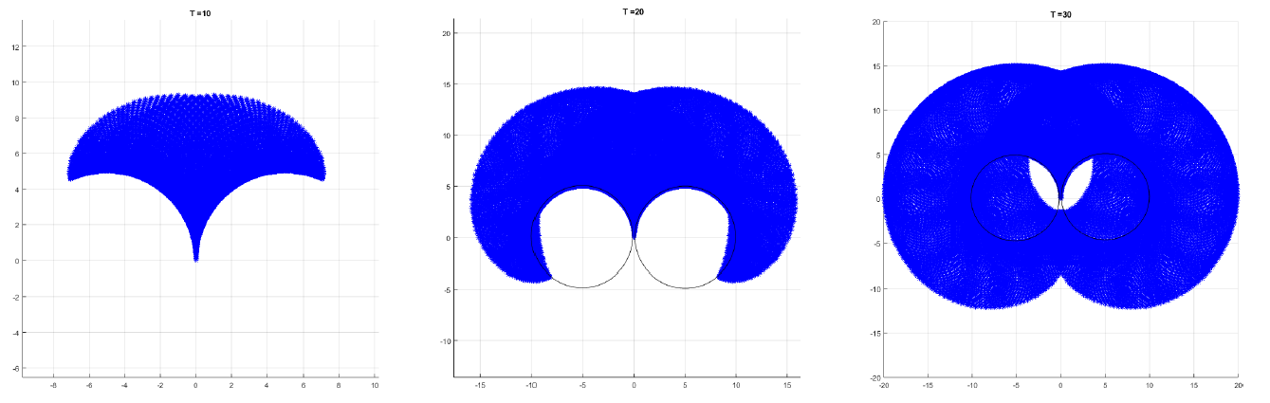
CC reachability sets
T = 10
T = 20
T = 30

Slide 6
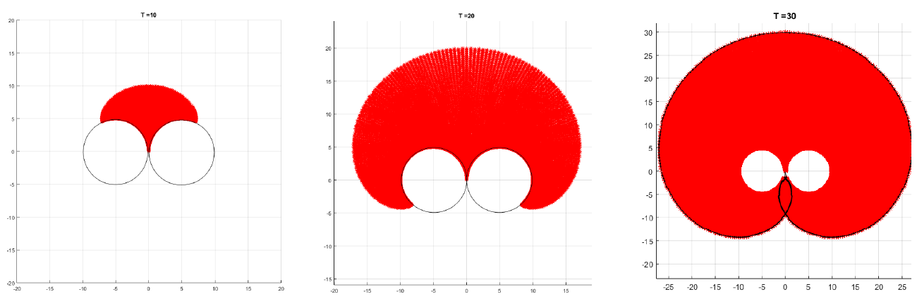
CL reachability sets
T = 10
T = 20
T = 30

Slide 7
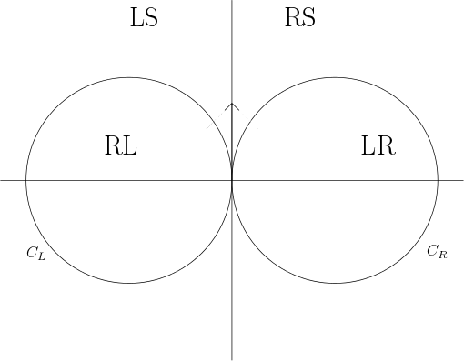
Characterization of 2-D plane
Any point outside the circles is reached fastest by CL curve
Any point inside the circles is reached fastest by CC curve

Slide 8
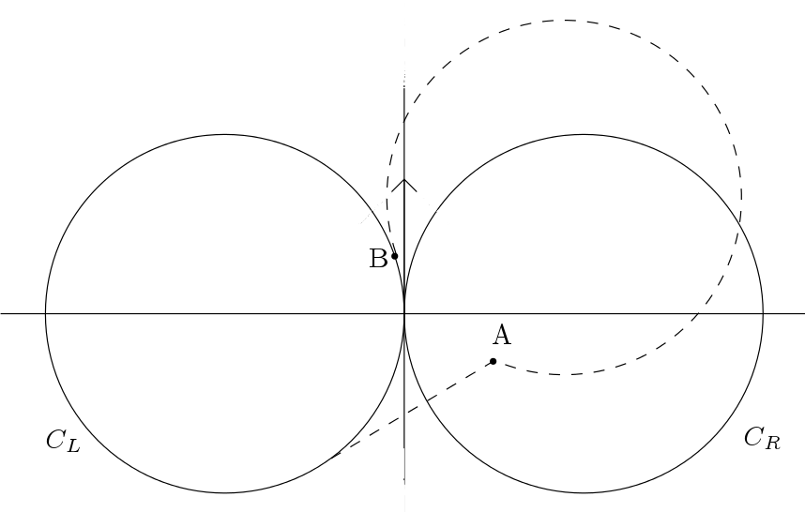
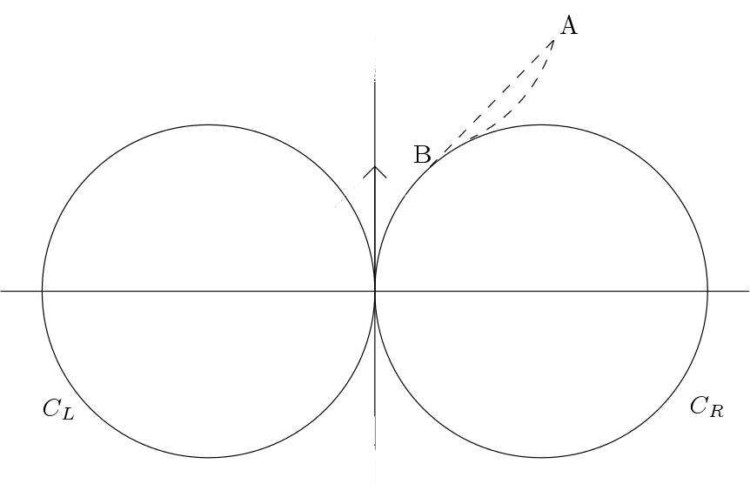
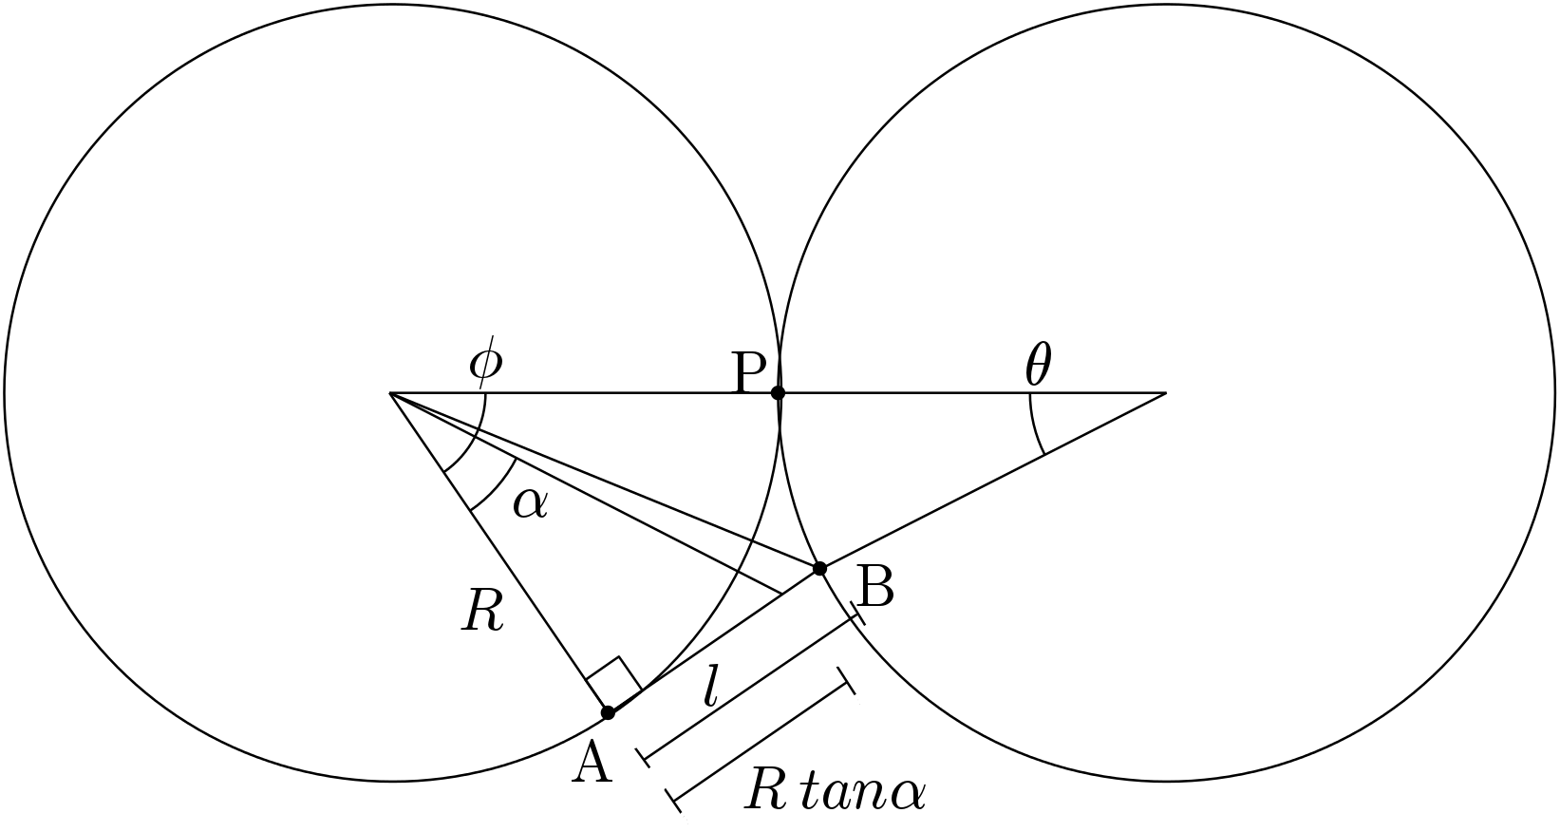
Sketch of Proof
CC
CL CC

Slide 9
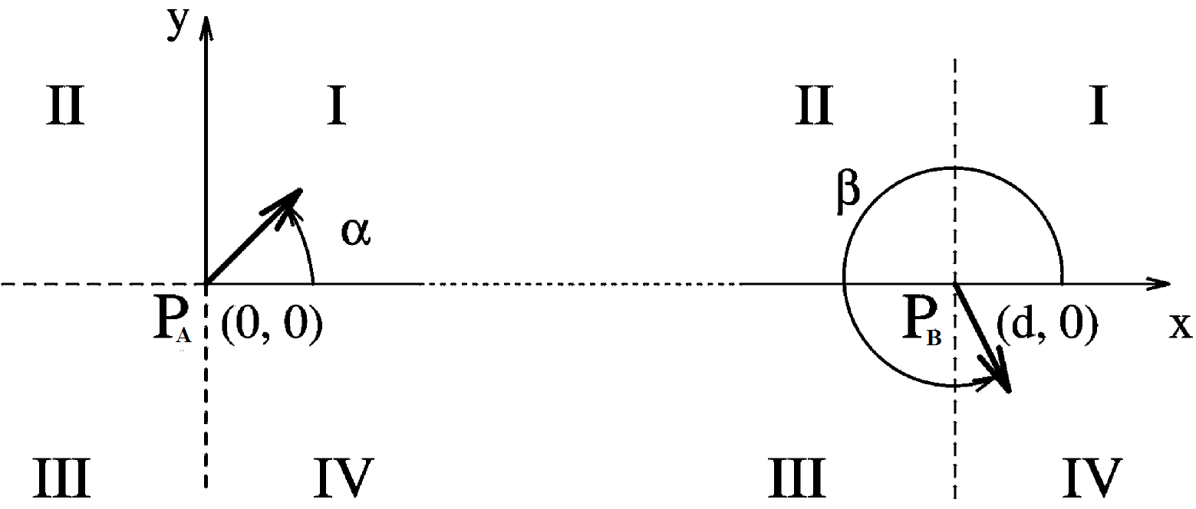
Two vehicle case
Categorizing the 2-D plane for two vehicles
Coordinate basis and study 16 combinations of quadrants

Slide 10
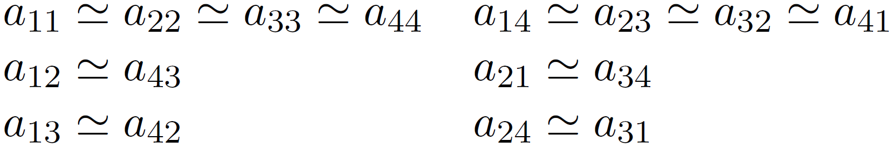
Equivalence groups
Symmetry along x and y axis
T(⍺,β)≃T(𝜋-β,𝜋-⍺) and T(⍺,β)≃T(-⍺,-β)
Number of possibilities reduced to 6 by establishing equivalence groups
Groups studied by increasing initial distance between the cars

Slide 11
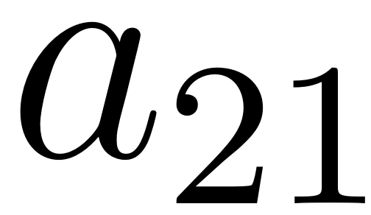
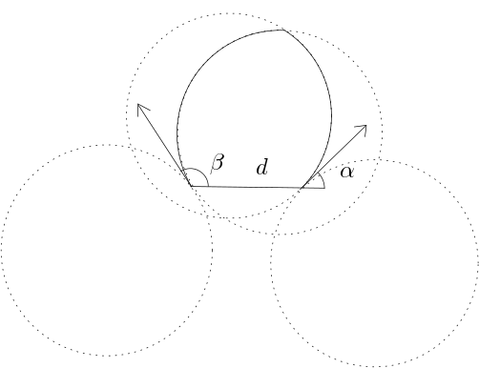
Shortest paths for

Slide 12
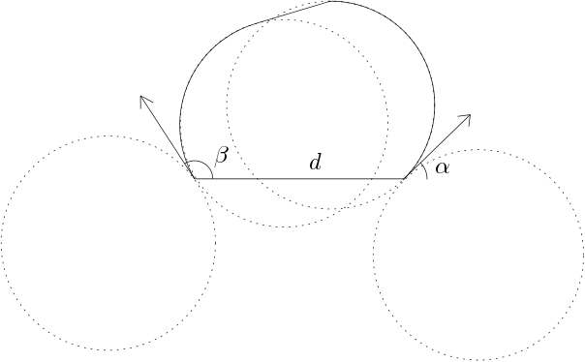
Shortest paths for

Slide 13
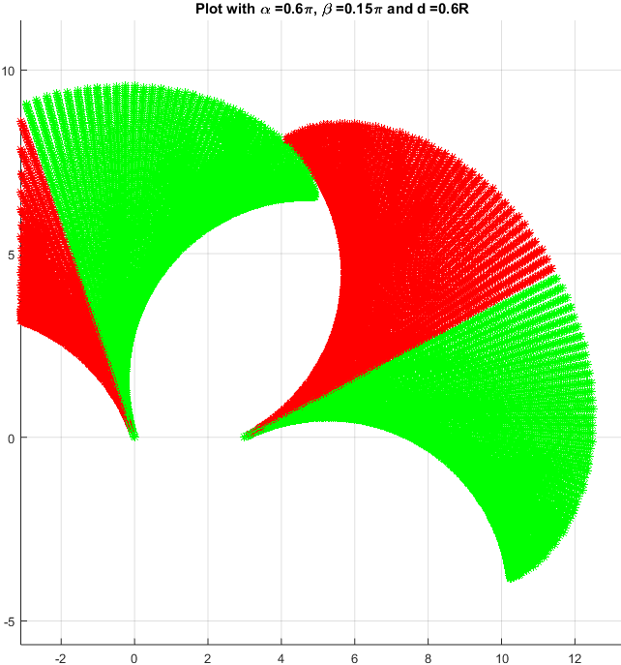
Shortest paths for
RS for vehicle A
LS for vehicle B

Slide 14
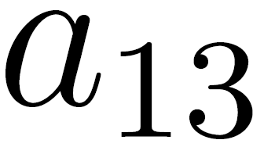
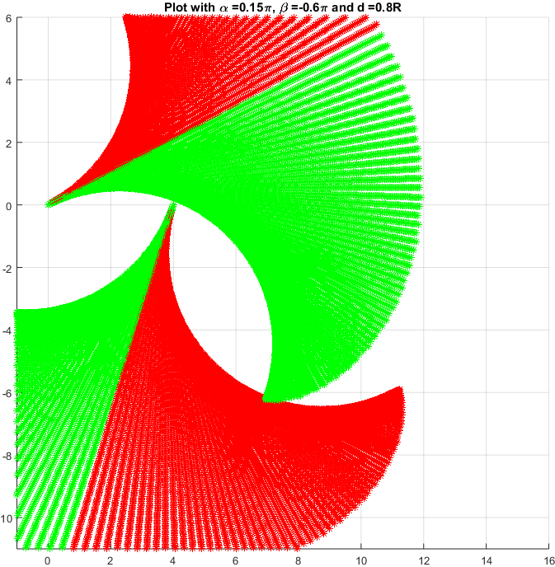
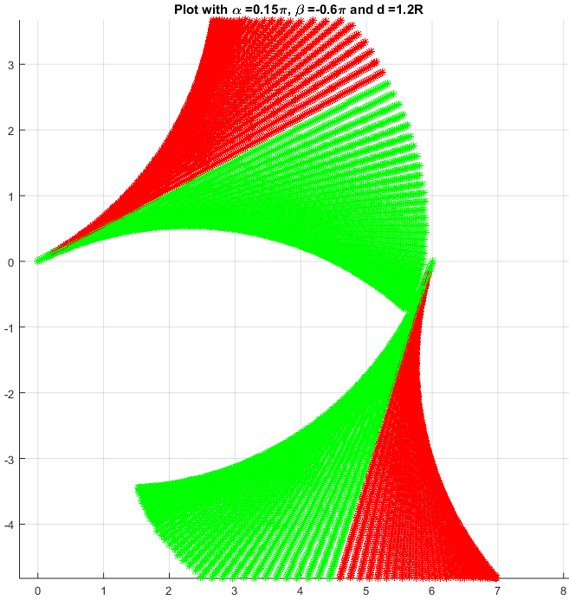
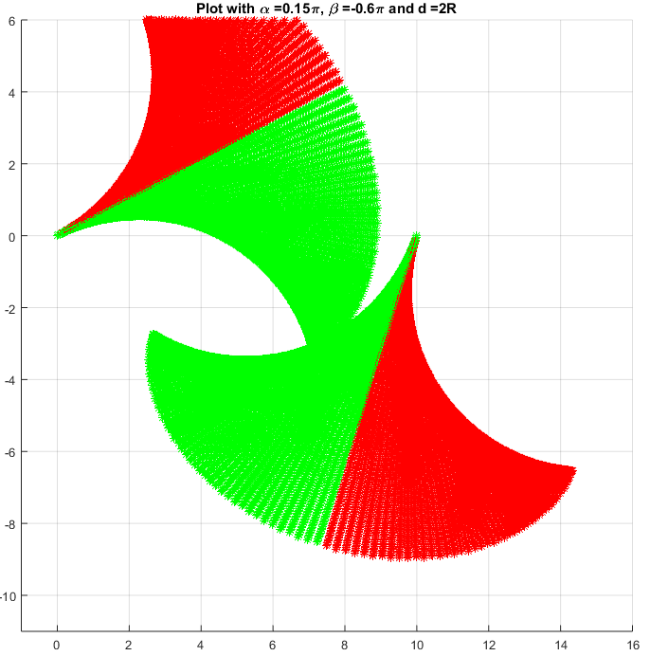
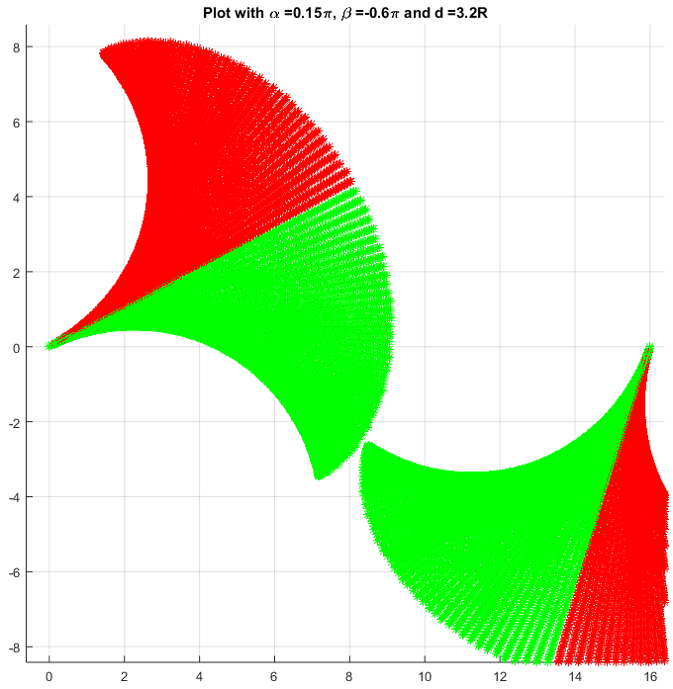
Shortest path for
d = 0.8r
d = 1.2r
d = 2r
d = 3.2r

Slide 15
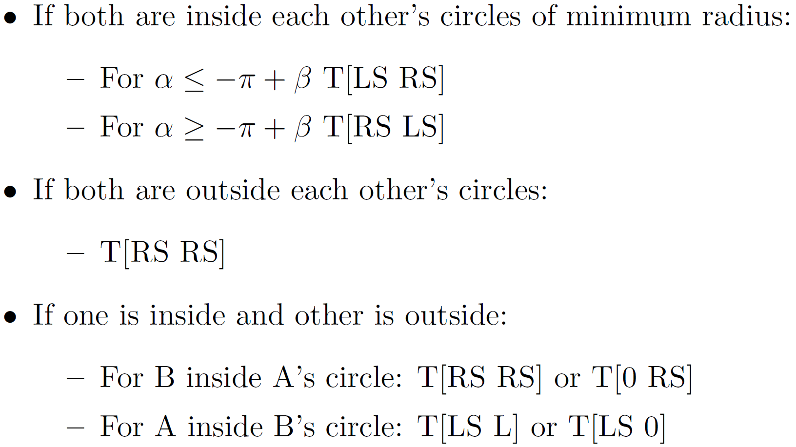
Shortest path for

Slide 16
Future Work
Geometric proofs for each of the observed cases
Calculation the exact rendezvous point from knowledge of the initial state
Formulate feedback based laws

Slide 17
Thank You

